Slide 1


Three-dimensional mapping of high-level music features for music browsing
Stefano Cherubin, Clara Borrelli, Massimiliano Zanoni, Michele Buccoli, Augusto Sarti, Stefano Tubaro

Slide 2
Introduction
Nowadays huge music libraries are available → information overload issue
Traditional organization of music based on meta-data is no longer sufficient, we need new paradigms to organize and retrieve music
How music content can be described?
Low Level Features
Mid Level Features: musicological properties
High Level Features: semantic description

Slide 3
Introduction
How music should be visualized by the user? Listing meta-data information is not enough, a more innovative approach is to display to the user more information about the music content
We propose a general framework for music browsing and retrieval based on 3-dimensional mapping of songs: high level descriptors are computed for each song and user will choose which descriptors will span the space

Slide 4
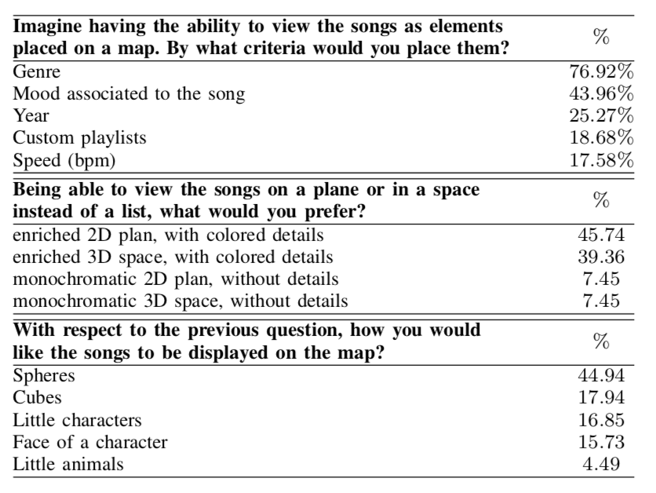
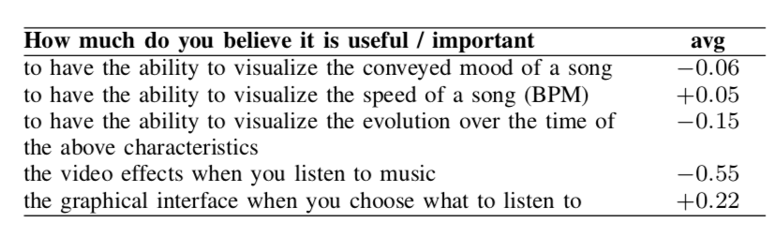
Motivations
We collected insights about users’ habits and preferences by a survey → which design features are important?
95 subjects, age 18-25 with high confidence in multimedia device usage
67.4% of them prefer to browse a music library with a map rather than with a list

Slide 5
Motivations
From the survey we derive a set of system requirements:
Personalization: user shoul be able to choose sorting criteria at runtime
Attractiveness: colorful and eniriched enviroment
Extensibility : the system can be expanded to implement new functionalities

Slide 6
Framework Architecture
AMBIF = Advanced Music Browing Interactive Framework

Slide 7
Framework Architecture
Music Library
audio files that can be analyzed and reproduced at runtime
Feature Extractor
automatic extraction of low level music features
automatic annotation of high level music features

Slide 8
Framework Architecture
Run Time Data
stores information needed at runtime (extracted features)

